Slide 1


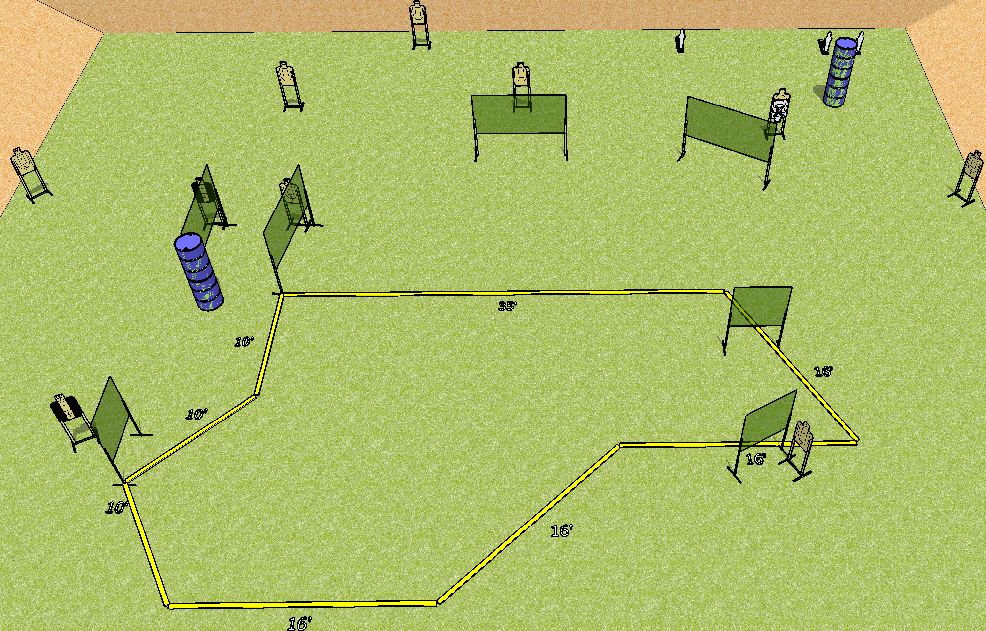
 | Dothan Gun Club – USPSA Match Where It Goes No One Knows Course Designer : Drew Coleman Bay: 3
Round Count 23 rounds 10 USPSA 3 mini poppers
Equipment List 14 wall feet 2 tux 9 targets (8 + 1 NS)

Slide 2
Where It Goes No One Knows
Written Stage Briefing
Scoring: Comstock Rounds: 23
Targets: 10 USPSA, 3 steel
Handgun start position: anywhere inside the shooting area, wrists below belt. Handgun is loaded and holstered.
PCC start position: anywhere inside the shooting area, stock on belt. Loaded carbine is held with both hands, safety on.
Stage Procedure: on the audible start signal, engage targets as they become available from within the shooting area.

